Slide 1
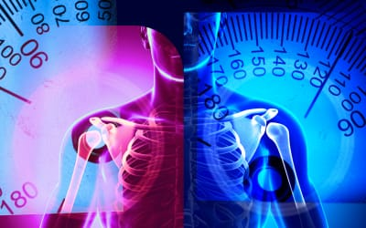
Digital Goniometer
TEAM MEMBERS:
TARANI J D
VIGNESH KUMAR S
SUGAPRIYA V

Slide 2
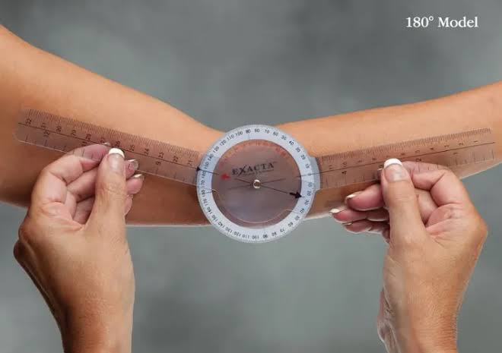
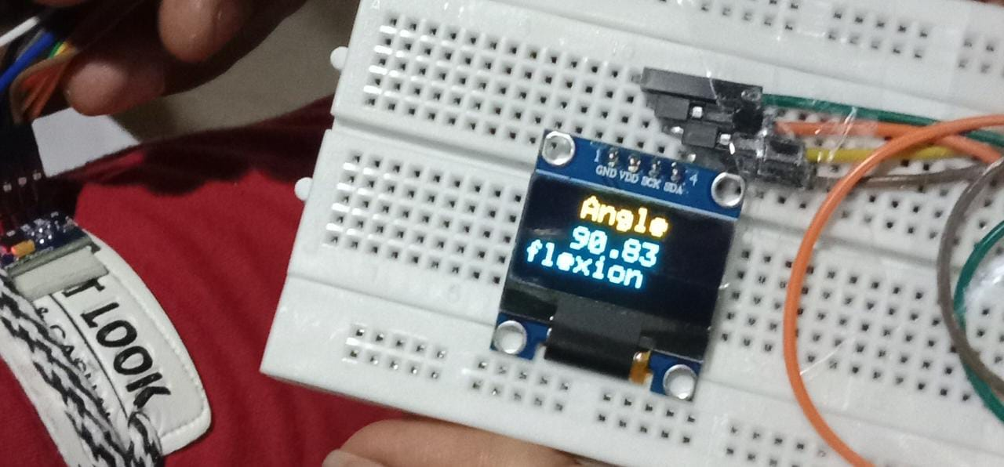
Problem statement
The conventional goniometer scale is widely used for measuring joint angles in medical fields, but it is inconvenient and requires manual assistance to use.
Patients may also face difficulty in accurately measuring their joint angles at home without professional help.
Therefore, there is a need for a portable and easy-to-use device that can accurately measure joint angles and enable patients to monitor their progress at home.

Slide 3
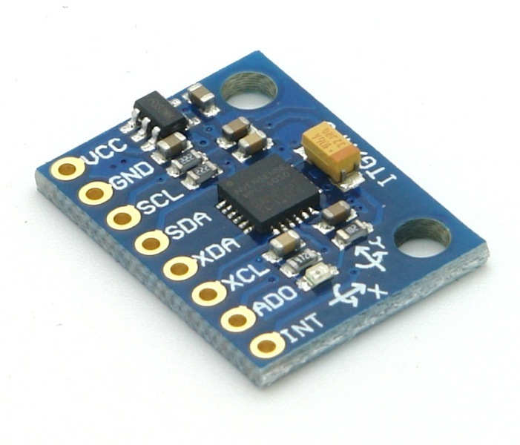
IMU Sensors
IMU stands for Inertial Measurement Unit.
IMU sensors are electronic devices that measure the movement and orientation of an object.
IMU sensors consist of accelerometers, gyroscopes, and magnetometers.
These sensors work together to detect changes in position, orientation, and velocity.

Slide 4
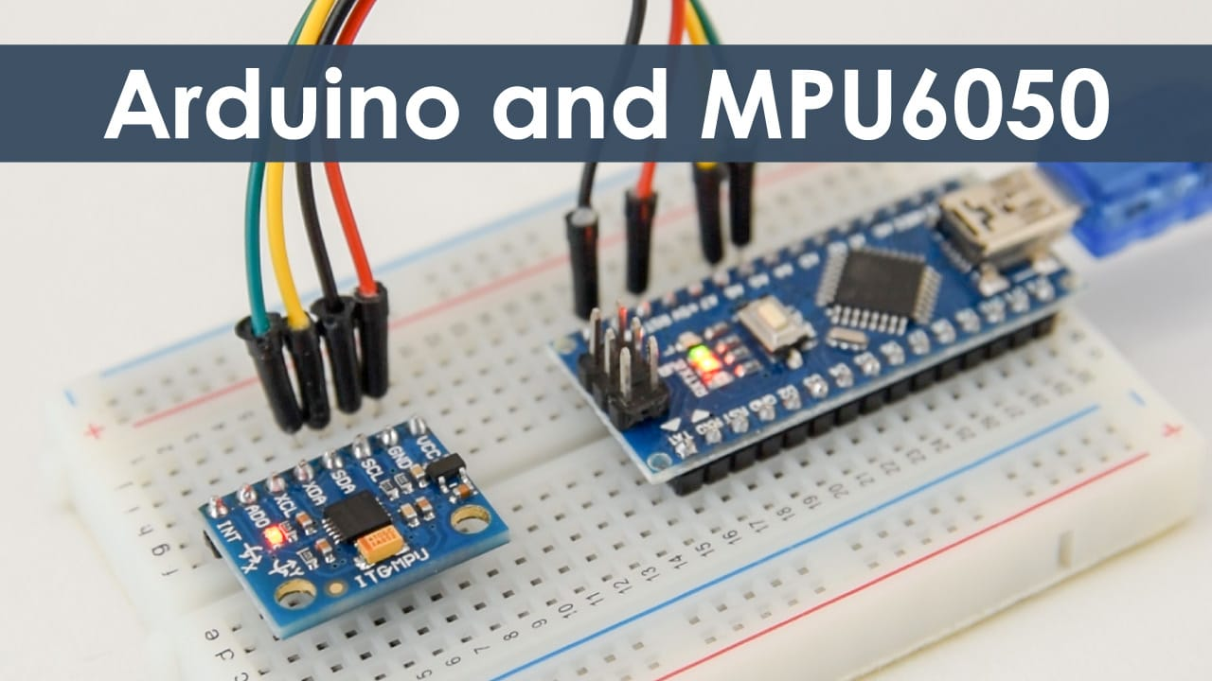
Device Architecture
The Digital Goniometer is designed using Arduino nano.
The device consists of a mpu6050 IMU sensor placed on the body.
The sensors are connected to the Arduino nano board.
The data from the sensors is processed using the Arduino programming language.

Slide 5
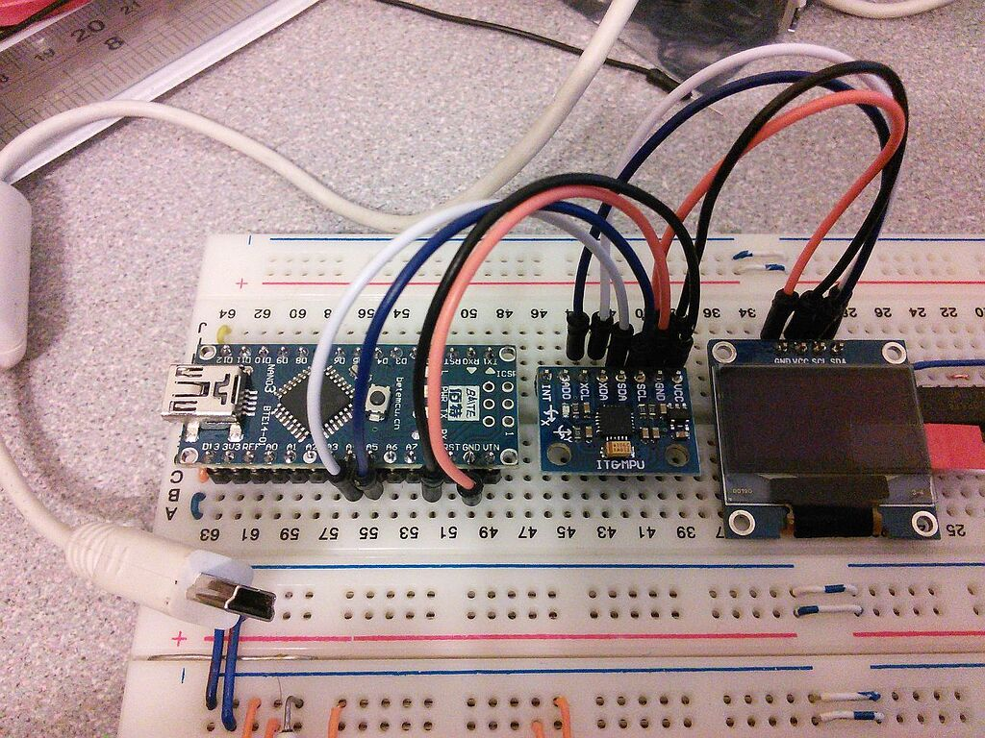
Benefits of Digital Goniometer
The Digital Goniometer is a non-invasive device that can accurately detect body movements.
The device can be used for therapy of paralysis patients.The device is portable and can be used in any location.
The device is cost-effective and can be used by anyone

Slide 6

Future advancement
To address the challenges associated with conventional goniometer scales, we have developed a digital goniometer device that utilizes IMU sensors to detect joint angles with accuracy and ease. Our device aims to provide a user-friendly interface that allows patients to monitor their joint movements and progress in real-time. In the future, we plan to incorporate additional features such as wireless connectivity, cloud storage, and AI-based analytics to further enhance the functionality and accessibility of our device. Our goal is to make the digital goniometer a standard tool in medical fields and a trusted companion for patients on their journey towards recovery.

Slide 7
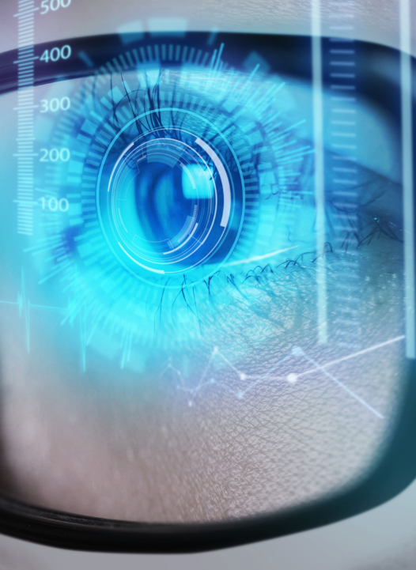


THaNK YOU
https://www.linkedin.com/in/tarani-jothi-6a53b1267
https://www.linkedin.com/in/sugapriya-v%F0%9F%92%AB-8a158a225
https://www.linkedin.com/in/vignesh-kumar-s-ece-a05a10226
tarani.jothi@gmail.com
vigneshsenthil62@gmail.com
sugapriyav22@gmail.com

